Slide 1

Combined Cycle Power Plant
Regression Model For The Prediction Of Energy Generated

Slide 2
Combined Cycle Power Plant
Group Members :
Mr.Tejas Popat Bachhav
Ms.Nikam Poonam Sanjay
Ms.Shirsath Shraddha Dattatray
Mr.Vijay Suresh Gangurde
Ms.Aishwarya Tulshiram Aher
Mr.Vivek Anchewar
Mr.Akshay Sagar K R

Slide 3
BUSINESS OBJECTIVE
A combined-cycle power plant comprises gas turbines, steam turbines, and heat recovery steam generators. In this type of plant, the electricity is generated by gas and steam turbines combined in one cycle. Then, it is transferred from one turbine to another. We have to model the energy generated as a function of exhaust vacuum and ambient variables and use that model to improve the plant's performance.

Slide 4
DATASET DETAILS
This is a project where the variable to be predicted is energy production The data file contains 9568 observations with five variables collected from a combined cycle power plant over six years when the power plant was set to work with a full load.
The variables, or features, are the following:
temperature, in degrees Celsius.
exhaust_vacuum, in cm Hg.
amb_pressure, in millibar. (Ambient pressure)
r_humidity, in percentage. (Relative humidity)
energy_production, in MW, net hourly electrical energy output.

Slide 5
EDA
Identifies general patterns in the data
Work Flow
Model Building
Exploring different models in Regression
Model Evaluation
Evaluating the model based on regression metrics
Model Deployment
Deploy the end results using flask/streamlit

Slide 6


Exploratory Data Analysis
Datatype
Correlation
Converting the datas into proper data type
Find the correlation between the datas
Null Values
Outliers
Check for null values,
if present replace them
Check for outliers in the data and handle them properly
Duplicate Records
Visualization
Check for duplicate records and drop them
if needed
Using proper visualizations in the datas for understanding the data

Slide 7
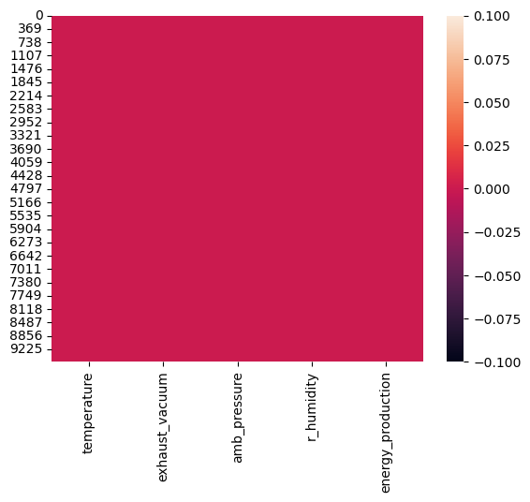
EDA(Exploratory Data Analysis)
1.NULL VALUES
Observation: There is no null value in the data set

Slide 8
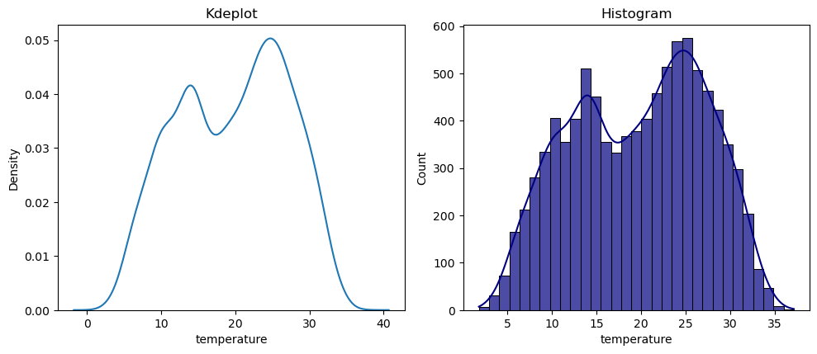
EDA(Exploratory Data Analysis)
2.Distribution Of The Data
Observation: temperature is negatively skewed(left skewed:-0.1363930494749227) and negative kurtosis (Platykurtic:-1.0375491923092452 )

Slide 9
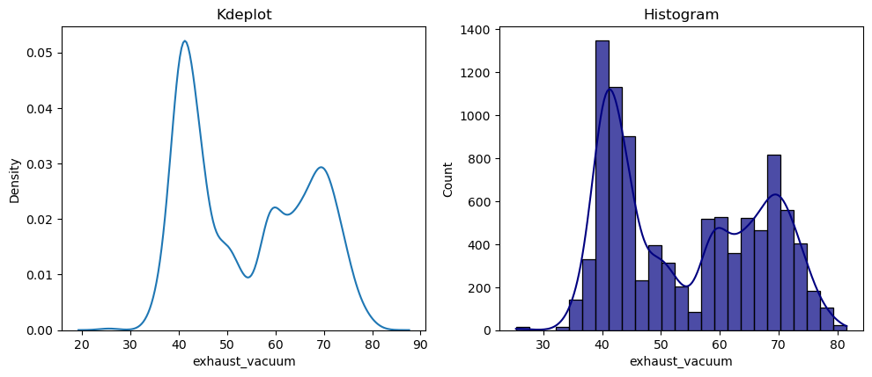
EDA(Exploratory Data Analysis)
2.Distribution Of The Data
Observation: exhaust_vacuum is positive skewed(Right skewed:0.19852101136676173) and negative kurtosis (Platykurtic:-1.4443366772319615)

Slide 10
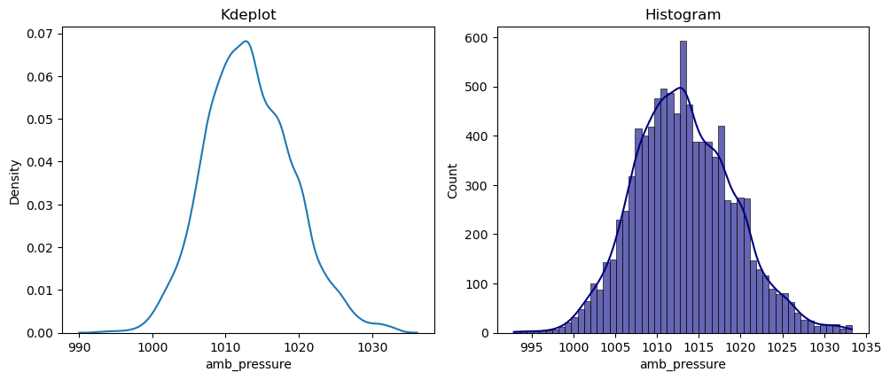
EDA(Exploratory Data Analysis)
2.Distribution Of The Data
Observation: amb_pressure is slightly positive skewed(Right skewed:0.26544469358258616) and positive kurtosis (Leptokurtic:0.09423719530331276)

Slide 11
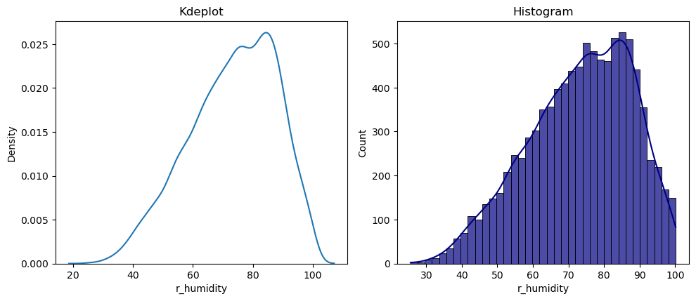
EDA(Exploratory Data Analysis)
2.Distribution Of The Data
Observation: r_humidity is negative skewed(Left skewed:-0.4318387491833359) and negative kurtosis (Platykurtic:-0.4445263744874066)

Slide 12
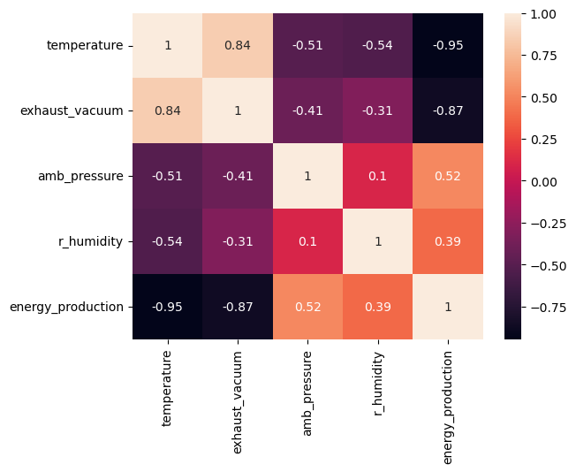
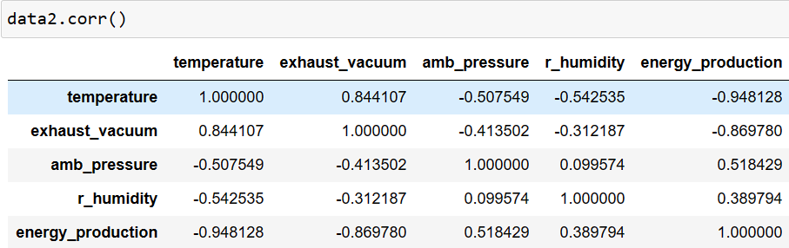
EDA(Exploratory Data Analysis)
3.CORRELATION & COVARIANCE
Observation: Energy Production is highly Negatively correlated with Temperature and Exhaust Vacuum
Temperature and Exhaust Vacuum is highly Positively correlated

Slide 13
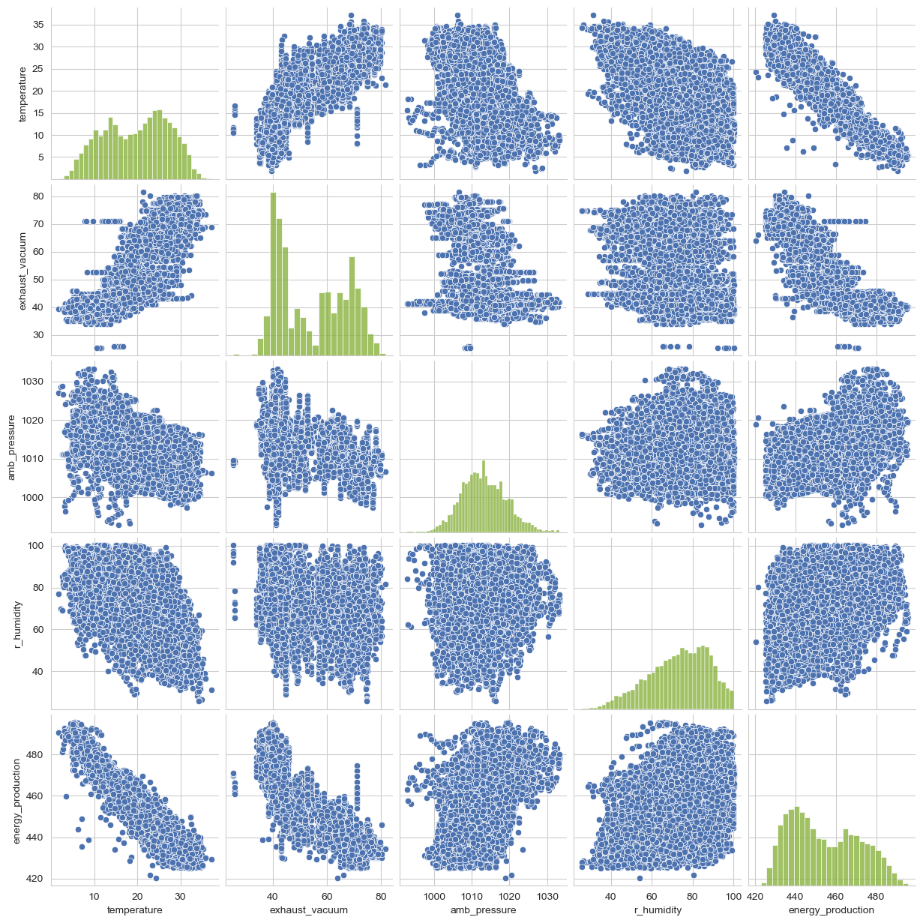
EDA(Exploratory Data Analysis)
3.CORRELATION & COVARIANCE
The energy production's negative covariance with temperature and exhaust vacuum, as well as the positive covariance between temperature and exhaust vacuum, are both plainly visible in the pairplot that displays the covariance of the features and target.

Slide 14
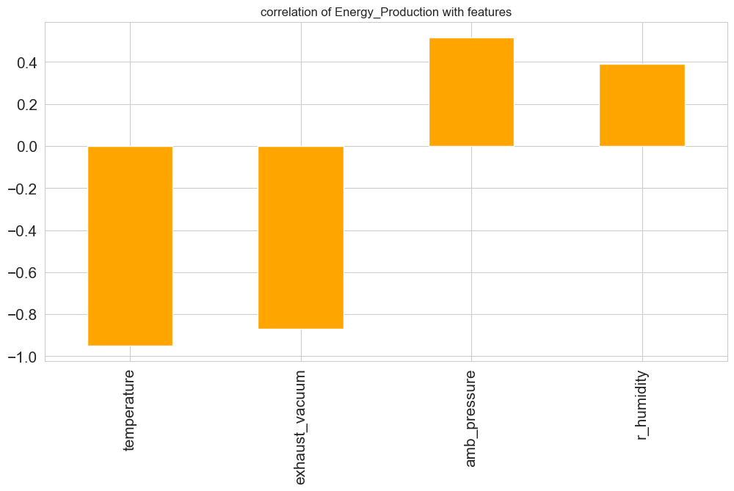
EDA(Exploratory Data Analysis)
3.CORRELATION & COVARIANCE
Observation: The bar plot shows the correlation of each features with the target variable ,This clearly shows the temperature and exhaust vacuum is negatively correlated while amb_pressure and r_humidity is positively correlated

Slide 15
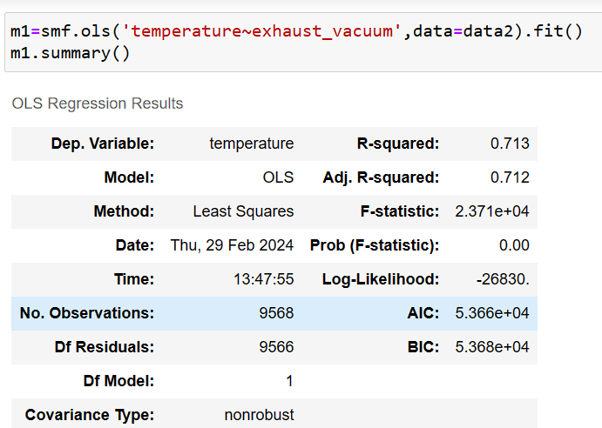
EDA(Exploratory Data Analysis)
3.CORRELATION & COVARIANCE
The high positive correlation between Temperature and Exhaust Vacuum is Multicollinearity
Problem
This clearly shows that the R-squared value is high.This indicates that temperature can be used to predict exhaust vacuum and vice versa.
If there is a correlation between the features, this problem is referred to be a multicollinearity problem according to the rules of multi linear regression.

Slide 16
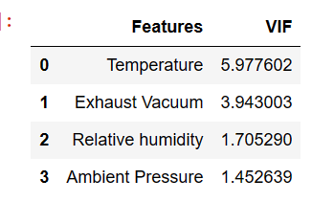
EDA(Exploratory Data Analysis)
3.CORRELATION & COVARIANCE
To solve the Multicollinearity Problem, we must determine the VIF.
The VIF is low for all Features so we don't want to drop any features

Slide 17
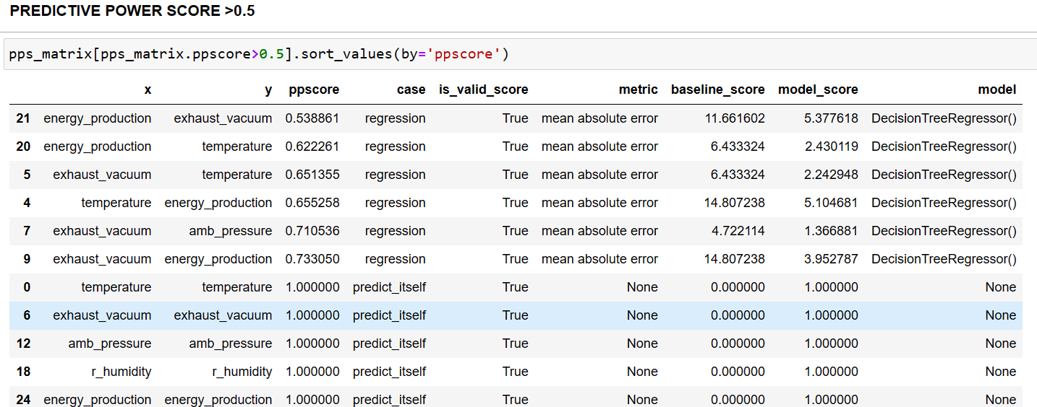
EDA(Exploratory Data Analysis)
3.CORRELATION & COVARIANCE
Predictive Power Score
Observation:The pps_matrix indicates the non linear relationship between the features

Slide 18
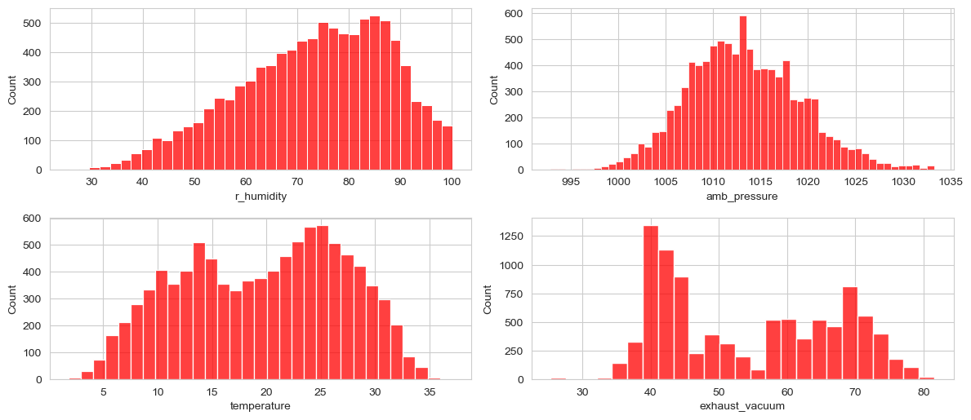
EDA(Exploratory Data Analysis)
4.OUTLIERS
Observation:Histogram can be used to identify the outliers ,but its not accurate

Slide 19
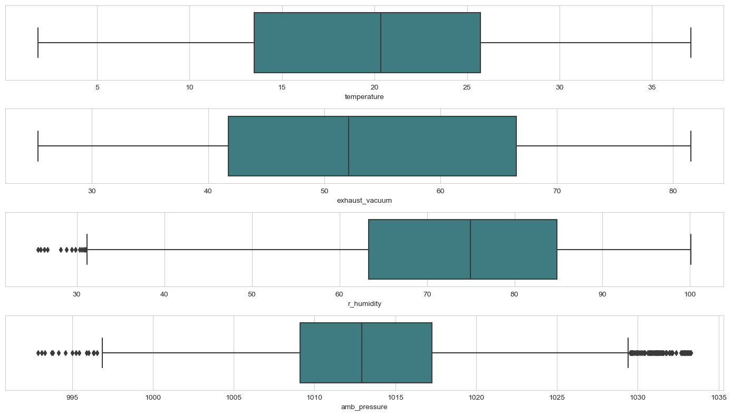
EDA(Exploratory Data Analysis)
4.OUTLIERS
Observation:The Box Plot displays the outliers' presence.

Slide 20
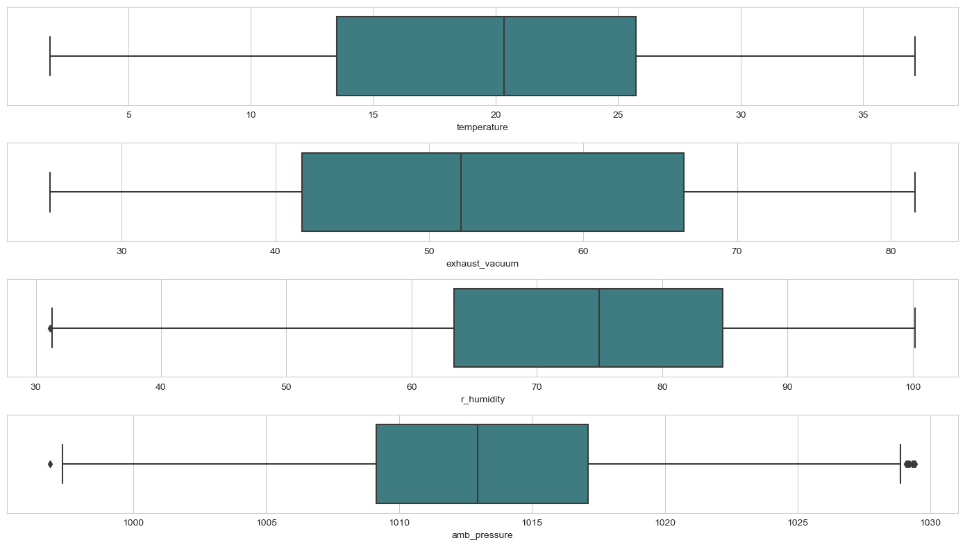
EDA(Exploratory Data Analysis)
4.OUTLIERS(Removing them using different methods)
Mean Imputation method: Substitute the mean value for the values present after lower and upper boundaries.Still there are some outliers present

Slide 21

EDA(Exploratory Data Analysis)
4.OUTLIERS(Removing them using different methods)
Median Imputation method: Substitute the median value for the values present after lower and upper boundaries.Still there are some outliers present

Slide 22
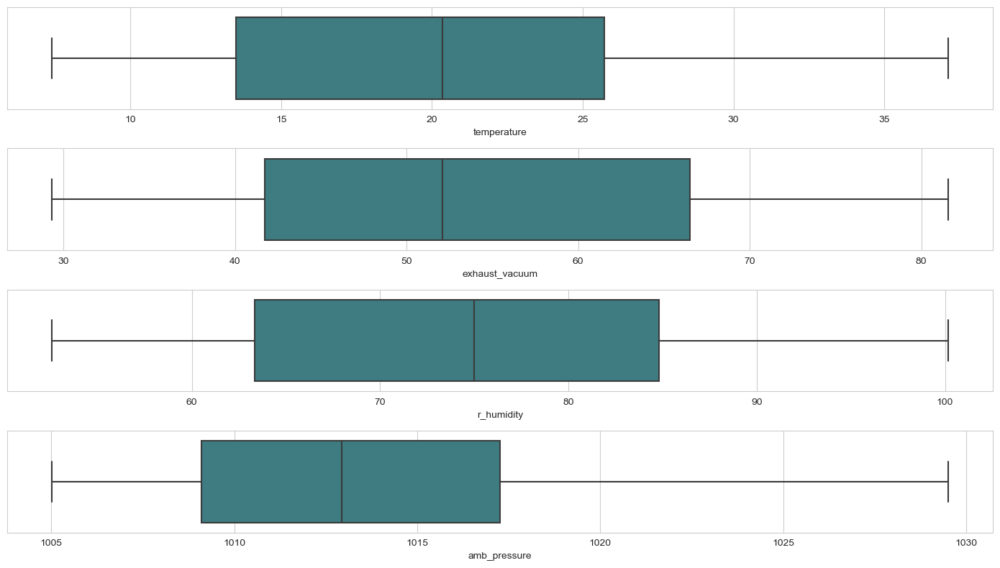
EDA(Exploratory Data Analysis)
4.OUTLIERS(Removing them using different methods)
Upper-lower Imputation method: Substitute the corresponding values for the values present after lower and upper boundaries.

Slide 23
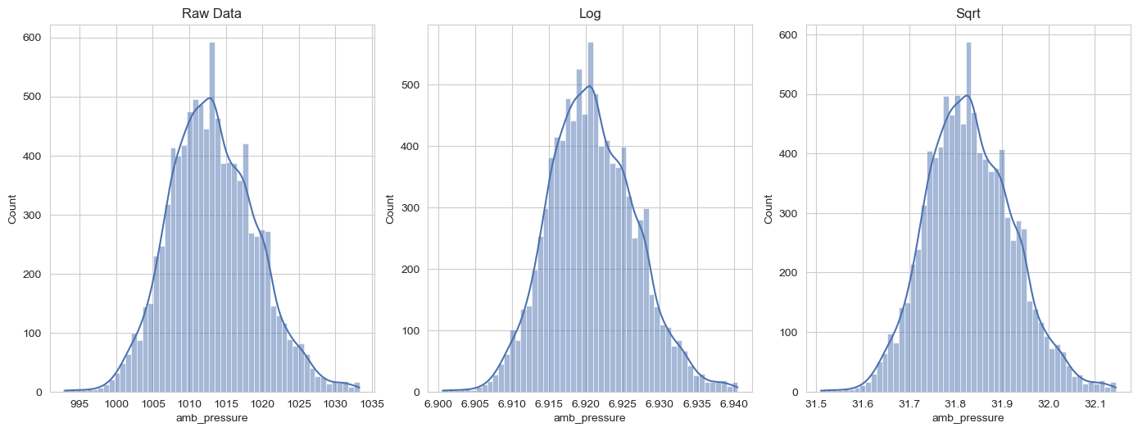
EDA(Exploratory Data Analysis)
5.Transformations on the dataset(amb_pressure)
Observation: Comparing Raw data with Log and Square Root transformed data
There is no significant change in the distribution

Slide 24
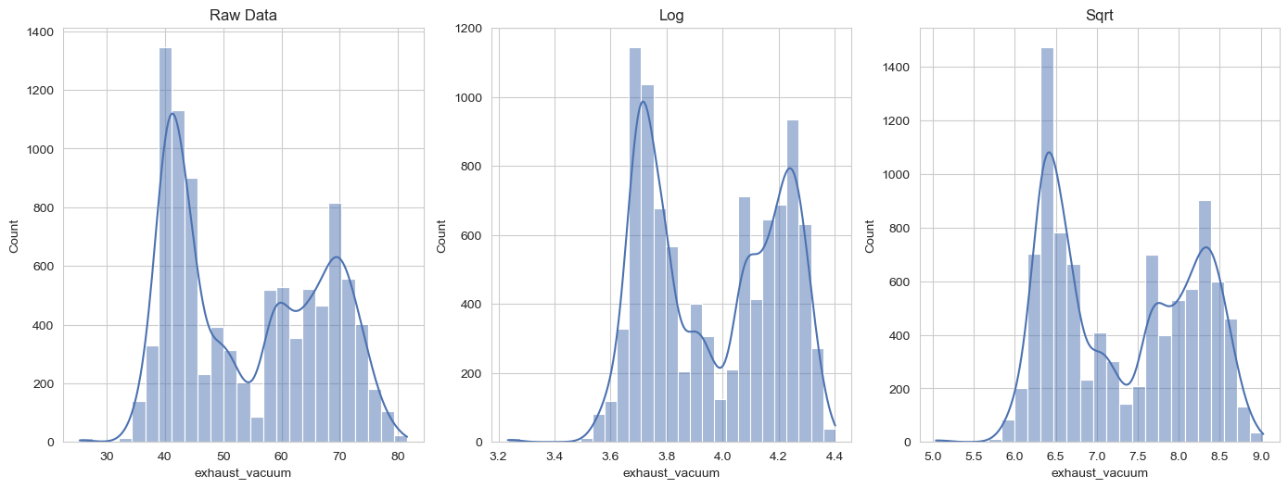
EDA(Exploratory Data Analysis)
5.Transformations on the dataset(exhaust_vacuum)
Observation: Comparing Raw data with Log and Square Root transformed data
There is no significant change in the distribution

Slide 25
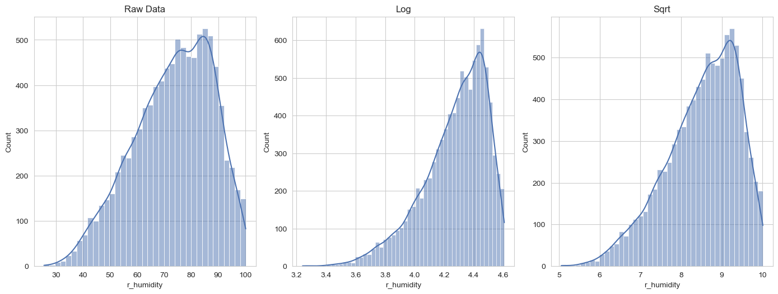
EDA(Exploratory Data Analysis)
5.Transformations on the dataset(r_humidity)
Observation: Comparing Raw data with Log and Square Root transformed data
There is slight change in the distribution

Slide 26
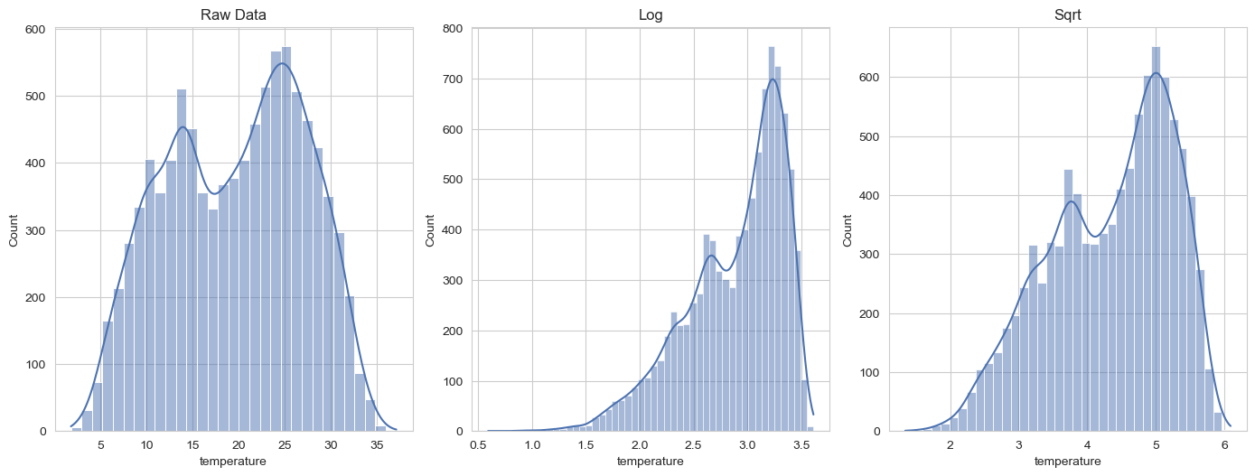
EDA(Exploratory Data Analysis)
5.Transformations on the dataset(temperature)
Observation: Comparing Raw data with Log and Square Root transformed data
There is slight change in the distribution

Slide 27
1
Multi Linear Regression
4
Regression
Models
Decision Tree Regression
2
Lasso Ridge
5
KNN Regressor
3
Ensemble Models

Slide 28
MODEL BUILDING
In order to develop various combinations of models, we will take into consideration various models(dtree,svr,knn…) and data transformations(sqrt,raw,log…)
We will take into account various model evaluation metrics, including r-squared value, rmse, mse, and amse.

Slide 29
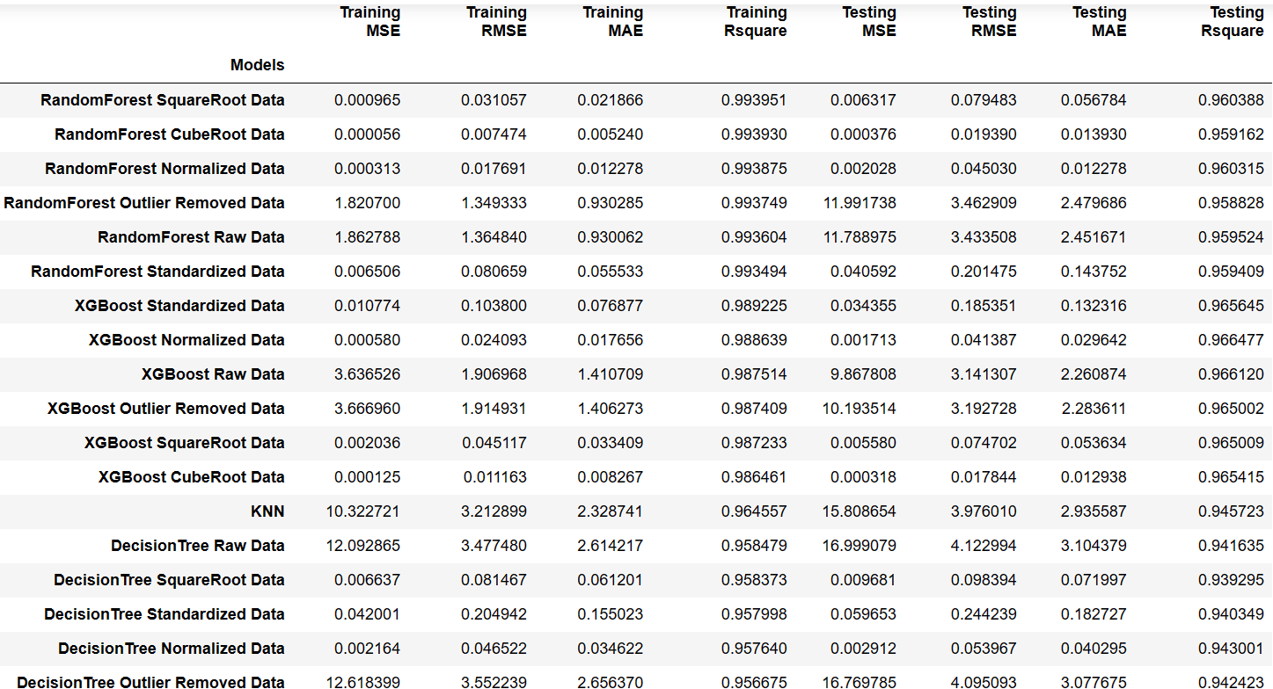
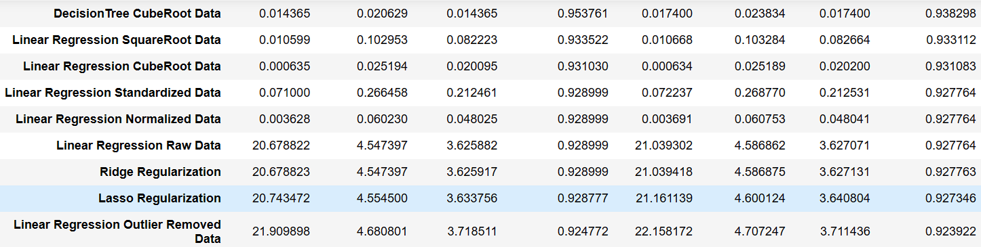
MODELS
(arranged according to the training R-Squared value)
Observation:
Random Forest Square Root Data have the best Training R-squared value

Slide 30
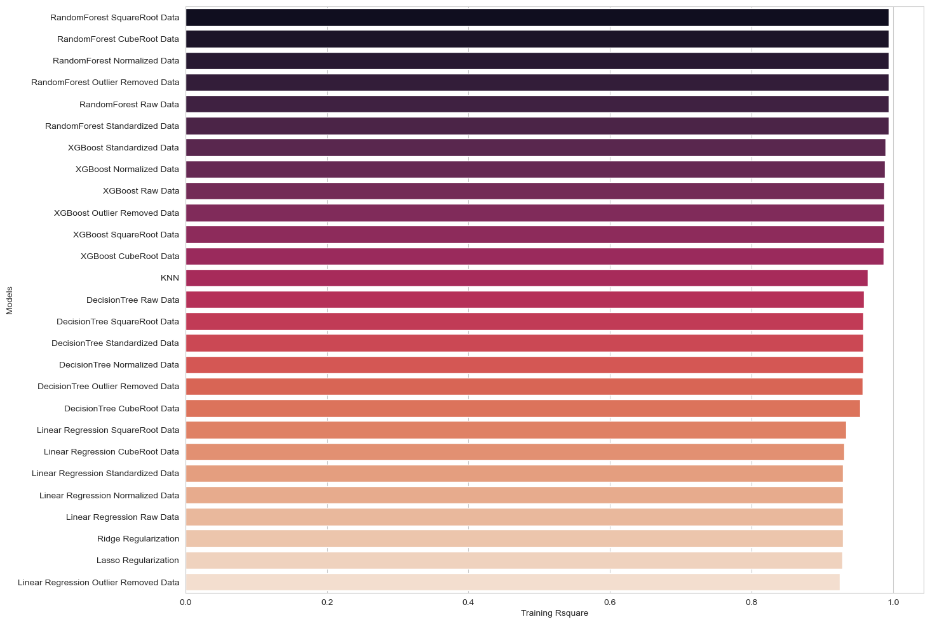
Visualization of Training R-Square

Slide 31
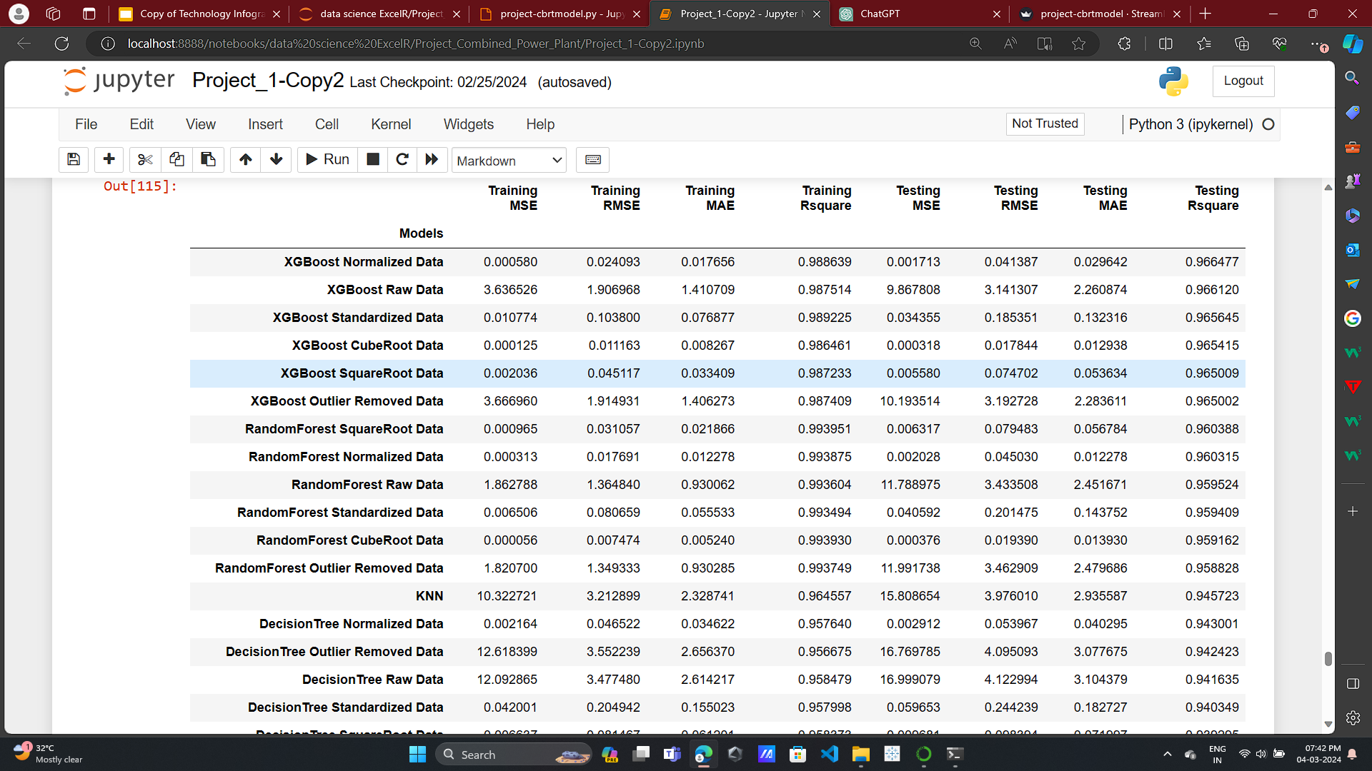
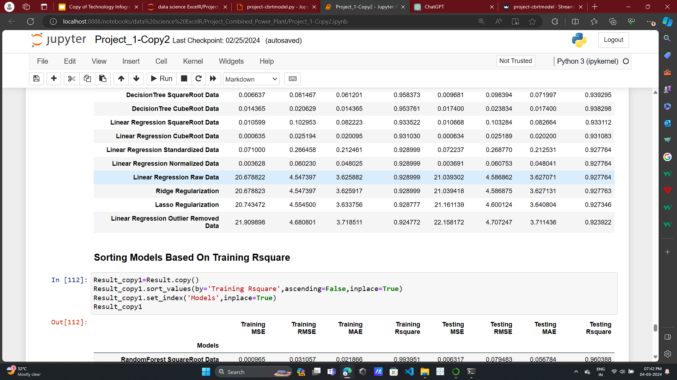
MODELS
(arranged according to the testing R-Squared value)
Observation:
XGBoost Normalized Data have the best Testing R-squared value

Slide 32
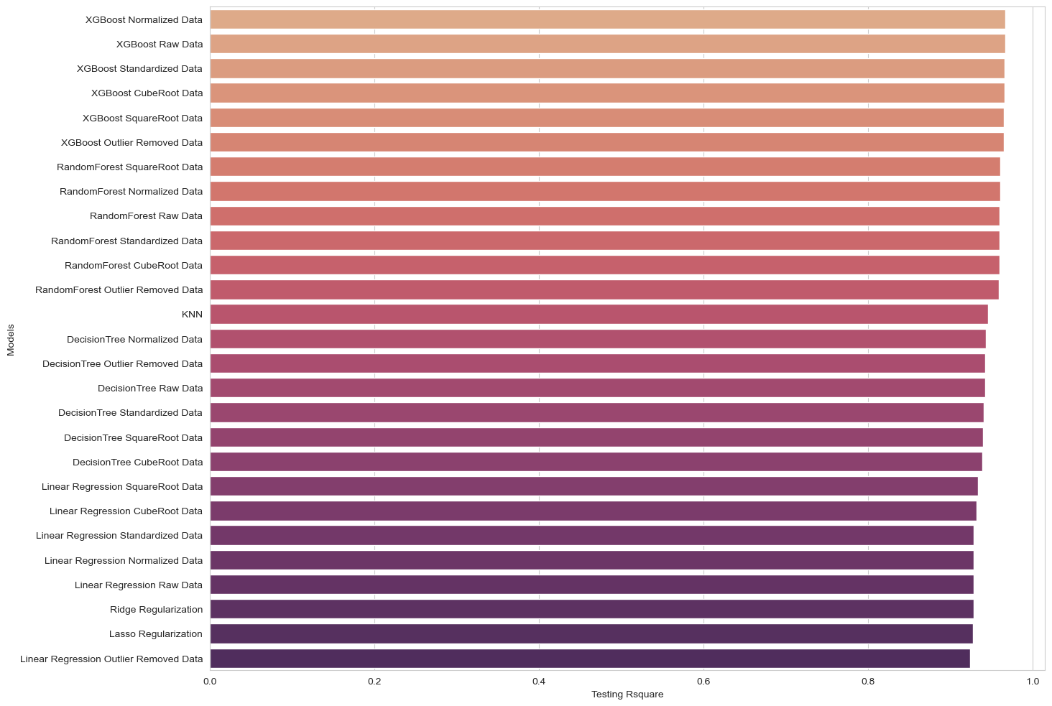
Visualization of Testing R-Square

Slide 33
FINAL MODEL
Since the XGBoost with Cube Root data Model has a best Testing and Training R squared value, we can select it as the final model

Slide 34
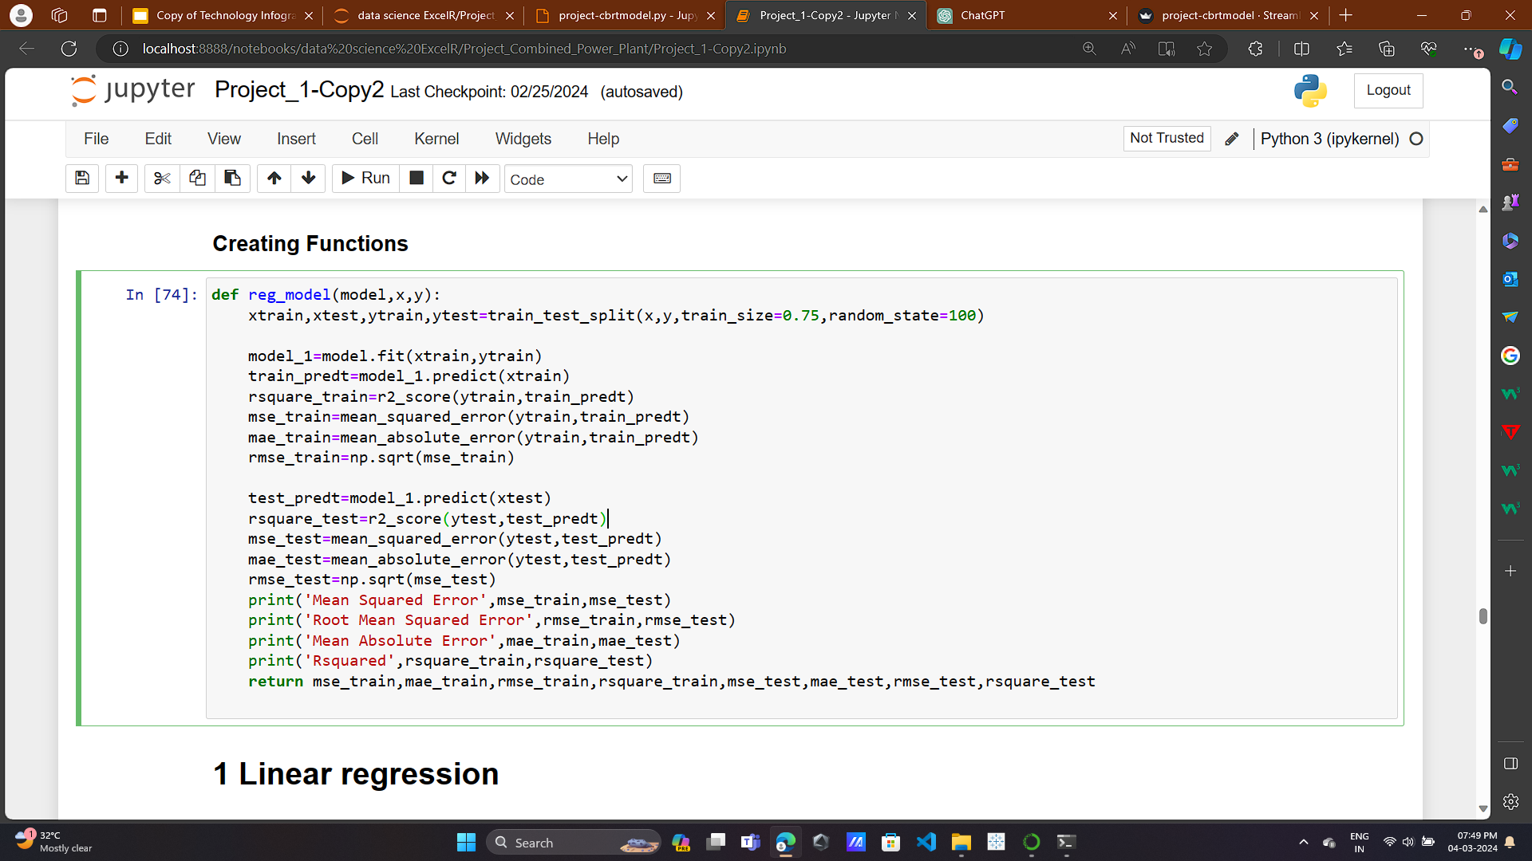
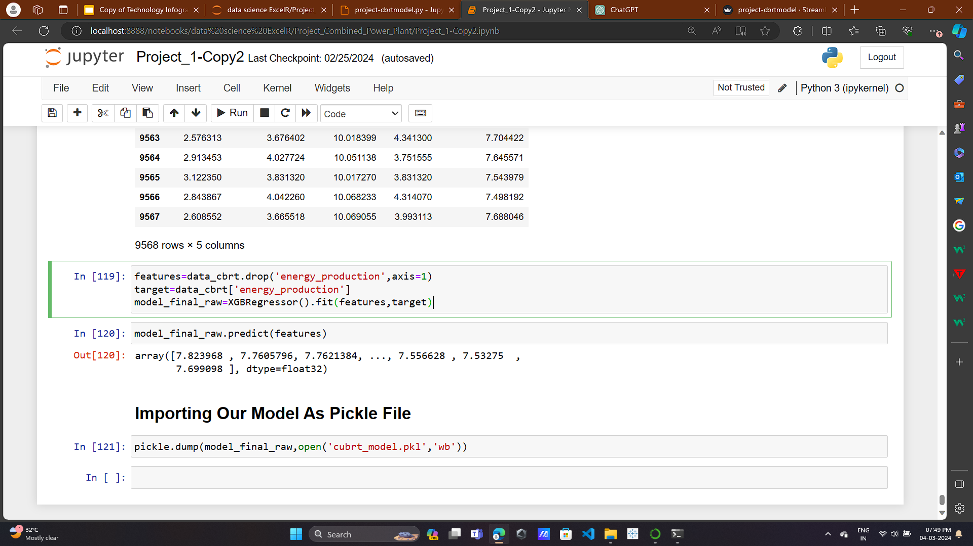
FINAL MODEL

Slide 35
STREAMLIT
Deploy the model using streamlit

Slide 36
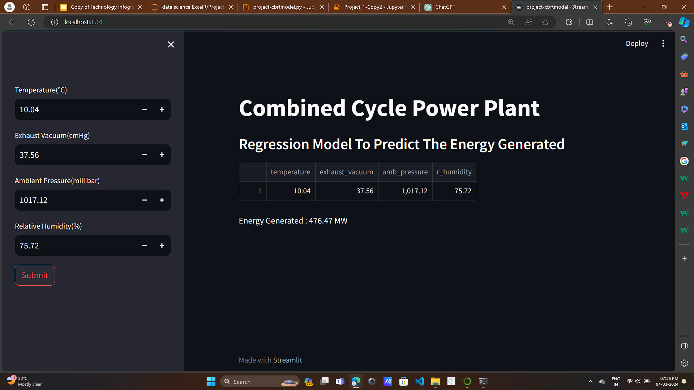
STREAMLIT

Slide 37
Thank You

